Slide 1
Monopolistic Competition
HS201

Slide 2
Introduction
Perfect competition, with an infinite number of firms, and monopoly, with a single firm, are polar opposites.
Monopolistic competition and oligopoly lie between these two extremes.

Slide 3
Introduction
Monopolistic competition is a market structure in which there are many firms selling differentiated products.
There are few barriers to entry.

Slide 4
Introduction
Oligopoly is a market structure in which there are a few interdependent firms.
There are often significant barriers to entry.

Slide 5
Characteristics of Monopolistic Competition
Four distinguishing characteristics:
Many sellers that do not take into account rivals’ reactions
Product differentiation where the goods that are sold aren’t homogenous
*Multiple dimensions of competition make it harder to analyze a specific industry, but these methods of competition follow the same two decision rules as price competition
Ease of entry of new firms in the long run because there are no significant barriers to entry
16-<number>

Slide 6
Output, Price, and Profit of a
Monopolistic Competitor
Like a monopoly,
The monopolistic competitive firm has some monopoly power so the firm faces a downward sloping demand curve
Marginal revenue is below price
At profit maximizing output, marginal cost will be less than price
Like a perfect competitor, zero economic profits exist in the long run
16-<number>

Slide 7
Many Sellers
When there are many sellers, they do not take into account rivals’ reactions.
The existence of many sellers makes collusion difficult.
Monopolistically competitive firms act independently.

Slide 8
Differentiated Products
The “many sellers” characteristic gives monopolistic competition its competitive aspect.
Product differentiation gives monopolistic competition its monopolistic aspect.

Slide 9
Differentiated Products
Differentiation exists so long as advertising convinces buyers that it exists.
Firms will continue to advertise as long as the marginal benefits of advertising exceed its marginal costs.

Slide 10
Multiple Dimensions of Competition
One dimension of competition is product differentiation.
Another is competing on perceived quality.
Competitive advertising is another.
Others include service and distribution outlets.

Slide 11
Easy Entry of New Firms in the Long Run
There are no significant barriers to entry.
Barriers to entry prevent competitive pressures.
Ease of entry limits long-run profit.

Slide 12
Output, Price, and Profit of a Monopolistic Competitor
A monopolistically competitive firm prices in the same manner as a monopolist—where MC = MR.
But the monopolistic competitor is not only a monopolist but a competitor as well.

Slide 13
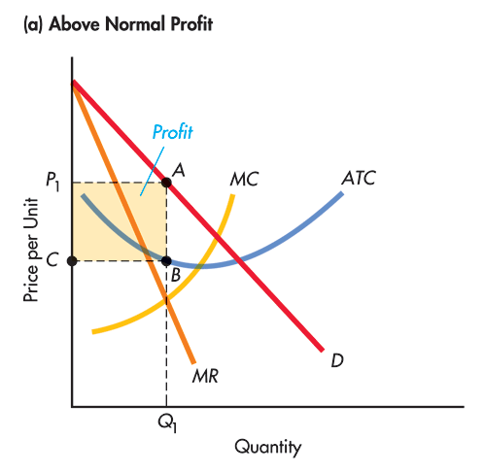
A Monopolistically
Competitive Firm: Above Normal Profit

Slide 14
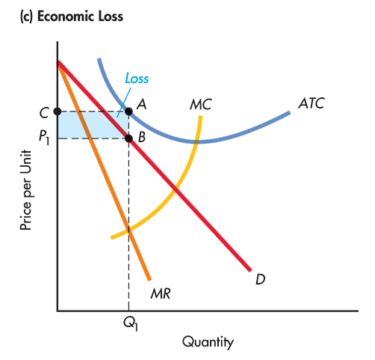
A Monopolistically
Competitive Firm: Economic Loss

Slide 15
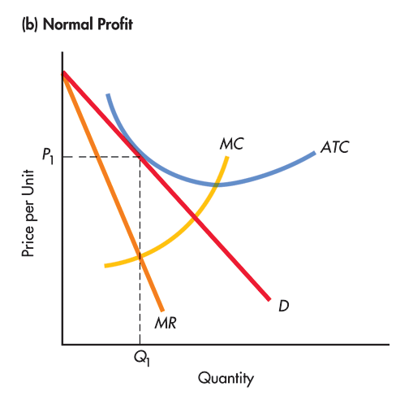
A Monopolistically
Competitive Firm: Normal Profit

Slide 16
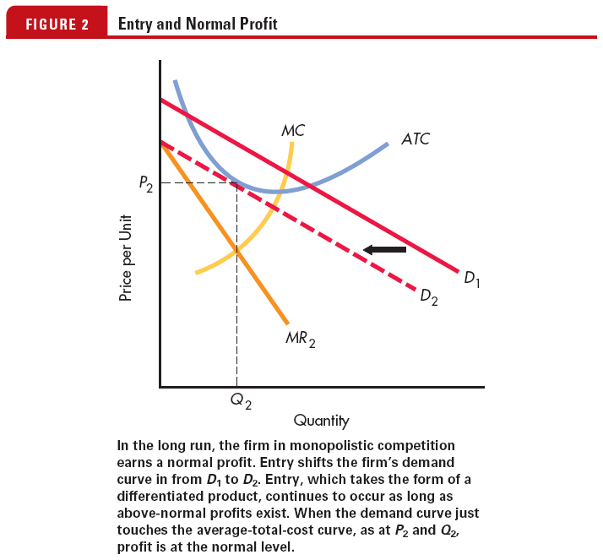
Entry and Normal Profit

Slide 17
Output, Price, and Profit of a Monopolistic Competitor
At equilibrium, ATC equals price and economic profits are zero.
This occurs at the point of tangency of the ATC and demand curve at the output chosen by the firm.

Slide 18
Monopolistic Competition
Price
MC
ATC
P_{M}
MR
D
0
Q_{M}
Quantity

Slide 19
Comparing Perfect and Monopolistic Competition
Both the monopolistic competitor and the perfect competitor make zero economic profit in the long run.

Slide 20
Comparing Monopolistic Competition with Monopoly
It is possible for the monopolist to make economic profit in the long-run.
No long-run economic profit is possible in monopolistic competition.

Slide 21
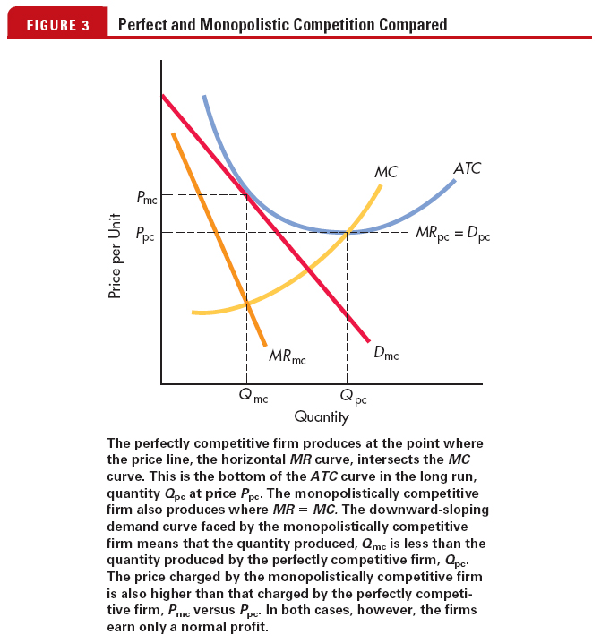
Perfect Competition and
Monopolistic Competition Compared

Slide 22
Monopolistic Competition Compared with Perfect Competition Graph
P
MC
In monopolistic competition in the long run, P > min ATC,
In perfect competition in the long run, P = min ATC
ATC
P_{MC}
P_{PC}
D_{PC}
Outcome:
Monopolistic competition output is lower and
price is higher than
perfect competition
D_{MC}
MR_{MC}
Q
Q_{MC}
Q_{PC}
16-<number>

Slide 23
Comparing Monopolistic Competition with Monopoly
It is possible for the monopolist to make economic profit in the long run because of the existence of barriers to entry
No long-run economic profit is possible in monopolistic competition because there are no significant barriers to entry
For a monopolistic competitor in long-run equilibrium, (P = ATC) ≥ (MC = MR)
16-<number>

Slide 24
Advertising and Monopolistic Competition
Perfectly competitive firms have no incentive to advertise, but monopolistic competitors do
The goals of advertising are to increase demand and make demand more inelastic
The increase in cost of a monopolistically competitive product is the cost of “differentness”
Advertising increases ATC
16-<number>

Slide 25
Nonprice Competition
The firm attempts to establish its product as a different product from that offered by its rivals.
Differentiation means that in the consumer’s mind, the product is not the same. Marketing is often the key to successful differentiation.

Slide 26
Nonprice Competition
Firms may differentiate products by perceived quality, reliability, color, style, safety features, packaging, purchase terms, warranties and guarantees, location, availability (hours of operation) or any other features.
Brand names may signal information regarding the product, reducing consumer risk.

Slide 27
Goals of Advertising
The goals of advertising include shifting the demand curve to the right and making it more inelastic.
Advertising shifts the ATC curve up.

Slide 28
Does Advertising Help or Hurt Society?
There is a sense of trust in buying brands we know.
If consumers are willing to pay for “differentness,” it’s a benefit to them.

Slide 29
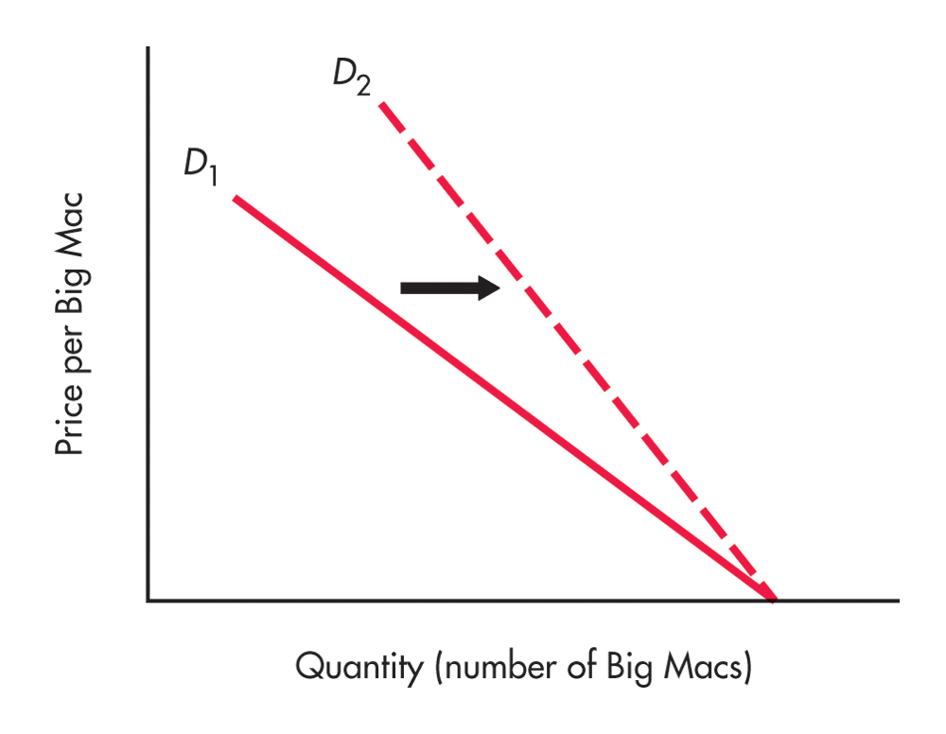
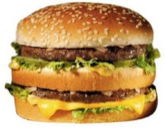
Advertising, Prices, and Profits
Product differentiation reduces the price elasticity of demand, which appears as a steeper demand curve. Successful product differentiation enables the firm to charge a higher price.

Slide 30
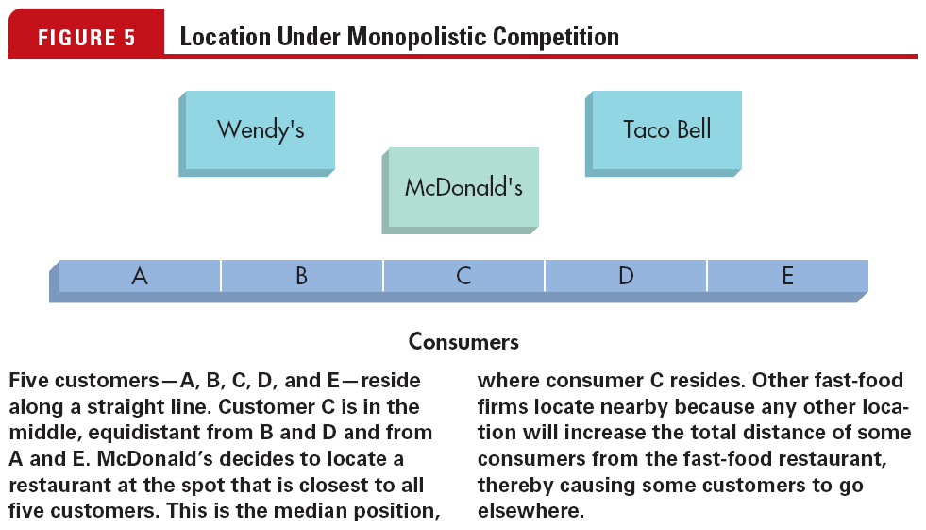
Location under
Monopolistic Competition

Slide 31
Brand Name
A brand name is valuable to a firm; it makes the demand less elastic and can enable the firm to earn higher profits.
Once a consumer has had a positive experience with a good, the price elasticity of demand for that good typically decreases—the consumer becomes loyal to the product.

